Slide 1
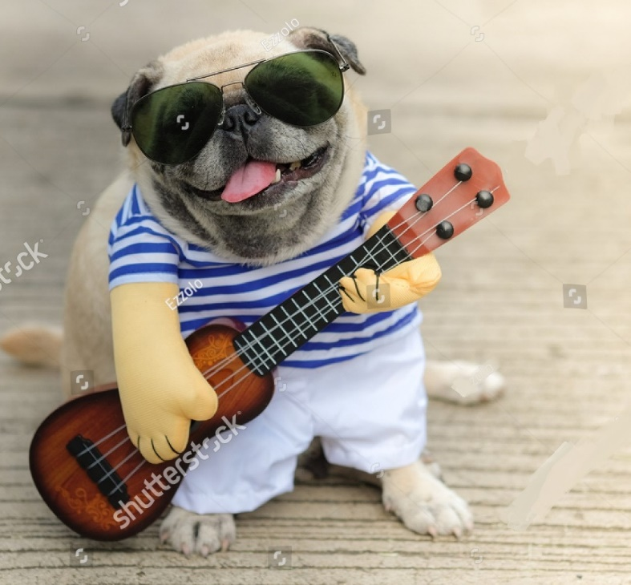
Guitar Tuner
Presented by:
Saheed Ullah 1606152
Sudipta Chandra Sarker 1606162
Md. Kamarujjaman Akash 1606163
Mahedi Hasan Nayeem 1506170

Slide 2

Tuning with perfect frequency is like the most precious thing to Smeagol.
Which can successfully be done by our project.

Slide 3
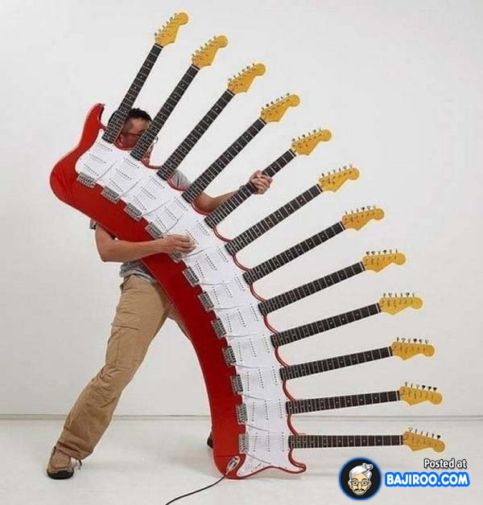
Purpose
More accuracy in tuning
Higher flexibility
Time saver
Better sound composition
Perfect instrument for begineer
Cheaper

Slide 4
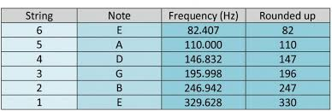
tuning process
by comparing input cord frequency with desired chord frequency given below we maximize the accuracy rate of tuning process
Allowable error in matching process 0.15%

Slide 5

algorithm
Enter the string number
Input audio signal using guitar
Matching input signal frequency with desired cord frequency
display perfect intonation
error ≥ 0.15%
YES
NO

Slide 6
Thank you

